Slide 1
Image
An image may be defined as a two dimensional function f(x,y), where x and y are spatial co-ordinates and the amplitude at any pair of co-ordinates and the amplitude at any pair of co-ordinates at is called the intensity or grey level of the image.
Image is collection of pixel
Pixel is the smallest item of information in an image

Slide 2
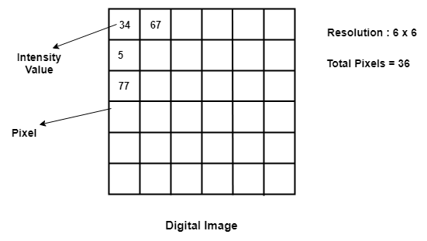

Slide 3
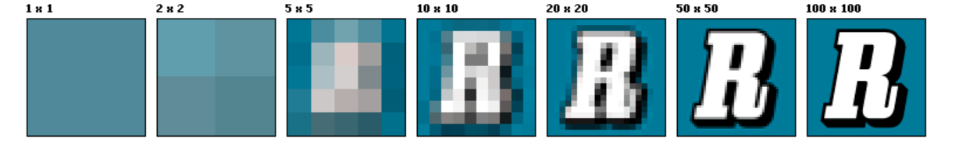
Image resolution
Resolution of an image is equivalent to the number of pixels in an image
Higher pixel number – higher the quality of image
Lower pixel number – lower the quality of image

Slide 4
Spatial resolution
Spatial resolution refers to the dimension of the pixel size representing the area covered on the ground. For example, if the area covered by a pixel is 5 x 5 meters, the resolution is 5 meters.
The higher the resolution of an image, the smaller the pixel size and the greater the detail.
For practical purposes the clarity of the image is decided by its spatial resolution, not the number of pixels in an image.

Slide 5
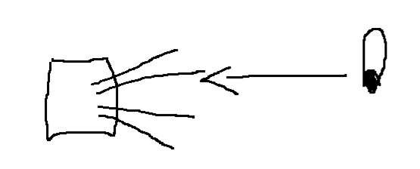
Brightness :
How far the eye is able to sense the luminance is called brightness.
It is not a physical unit
It can be adjusted by add or subtract the brightness factor
Luminance:
It is a measure of anything that projects light .
eye
brightness
luminance

Slide 6
Intensity
Power per unit area
It is a physical quantity
An image is defined as a two-dimensional function f(x, y) the amplitude of f at any pair of coordinates (x, y) is called the intensity or gray level of the image at that point.

Slide 7
Contrast
Contrast refers to the amount of color or grayscale differentiation that exists between various image features in digital images.
Images having a higher contrast level generally display a greater degree of color or grayscale variation than those of lower contrast.
Contrast is the difference between the maximum and minimum pixel intensity of an image.
Contrast = maximum pixel intensity - minimum pixel intensity

Slide 8
Deficiencies in digital image contrast can often be corrected by utilizing an intensity transformation operation, which is an algorithm designed to transform each input brightness value to a corresponding output brightness value via a transfer function
Linear transformation
Logarithmic transformation
Power law

Slide 9
Linear transformation
Linear transformation includes simple identity and negative transformation.
Identity transformation
Input image is directly mapped to the output image value
The resultant image is same as the input image
Negative transformation
It is invert of identity transformation.
Each value of the input image is subtracted from the L-1 and mapped onto the output image.

Slide 10
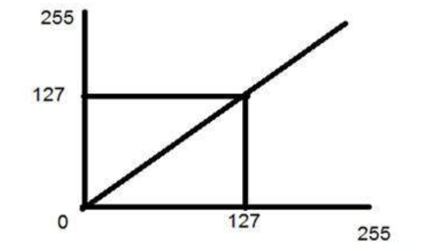
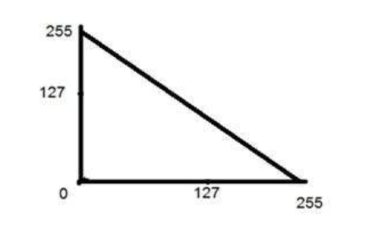
Negative transformation,
s = (L – 1) – r
Identity transformation
Negative transformation

Slide 11
Logarithmic transformation
s = c log(r + 1).
During log transformation, the dark pixels in an image are expanded as compare to the higher pixel values. The higher pixel values are kind of compressed in log transformation. This result in following image enhancement.

Slide 12
Power – Law transformations
s=cr^γ
Variation in the value of γ varies the enhancement of the images. Different display devices / monitors have their own gamma correction, that’s why they display their image at different intensity.

Slide 13
